Slide 1
We Need woman Health data

Slide 2
Zakia
Covid 19 Deaths Visualization

Slide 3
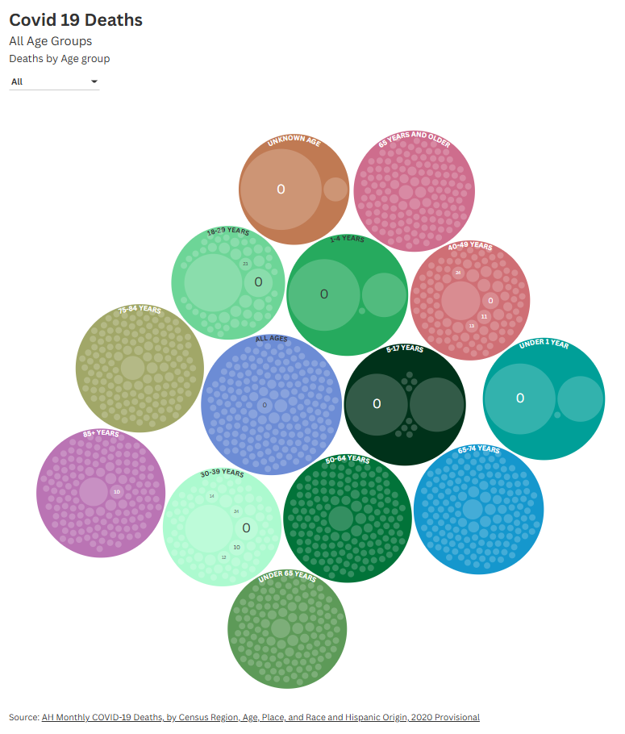

All Age groups for covid 19 deaths

Slide 4
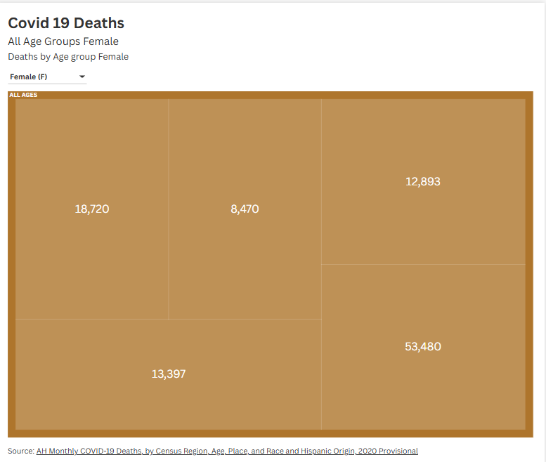
Covid 19 Deaths -FEMALE
Covid 19 deaths by female
All Ages Groups
The highest group was the 65 and older females
https://public.flourish.studio/visualisation/29255464/

Slide 5
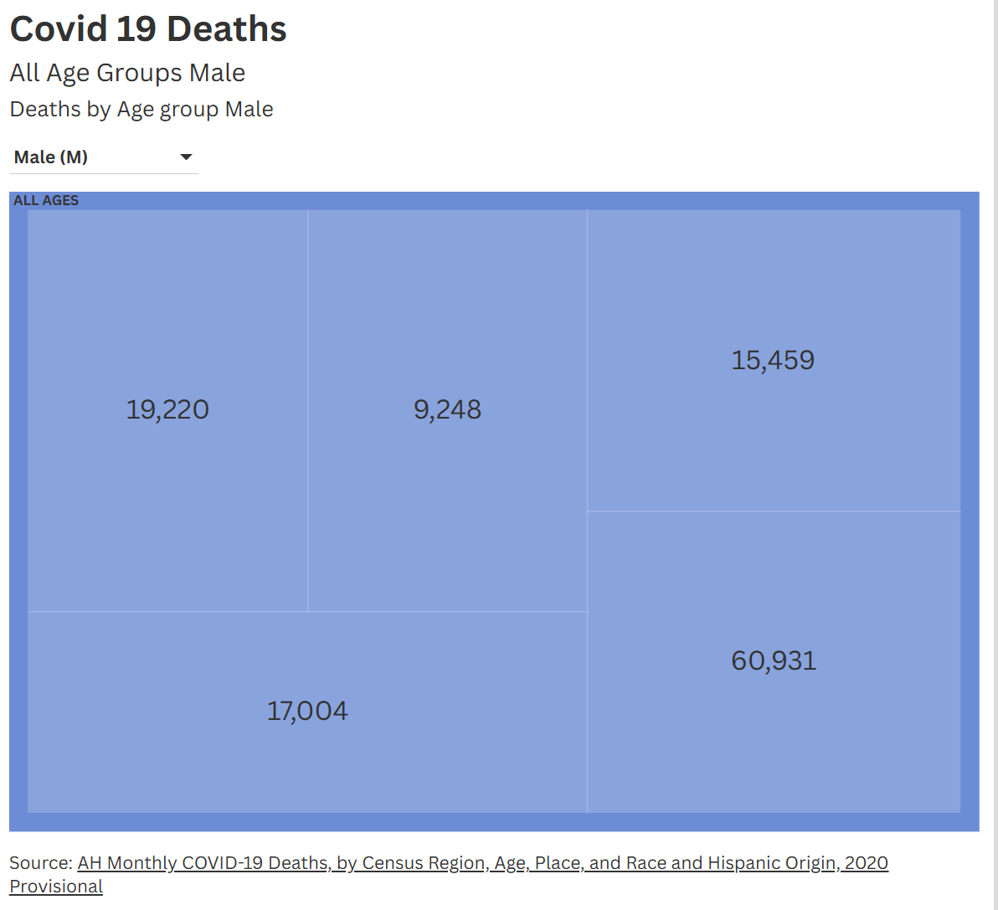
Covid 19 deaths – Male Group
https://app.flourish.studio/visualisation/29255464/edit

Slide 6

Where did the data come from
This data was provided by the CDC Center for Disease Control I think what makes me want to look at this is the lack of data and the lack of public data on woman's health.

Slide 7
DATA
Narrative
I chose to focus on woman health data and used charts that I felt were important that needed to show the differences in the data on male and female as well. I noticed that this data set did not differentiate between the male, female non-binary demographics it just lumped everyone together and that is something that is seen a lot in large scale health data.

Slide 8
Changing the Narrative
Advocating for woman health data is something that needs to be done to increase them. The CDC has woman's health data although we still need more.

Slide 9
Works Cited
https://data.cdc.gov/National-Center-for-Health-Statistics/AH-Monthly-COVID-19-Deaths-by-Census-Region-Age-Pl/w4jm-mysj/about_data

Slide 10

Questions?​

